Slide 1
Mapping rules for Echonet
Andreas Sayegh, Deutsche Telekom
HGI Q4/2014, Paris
Intended for: SHTF
Document No. HGIxxxx

Slide 2
Purpose of this contribution
Propose rules to map Echonet models into the SDT

Slide 3
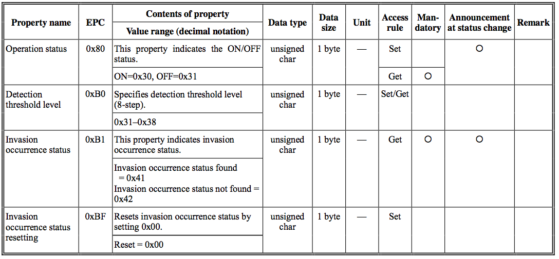
Examples from Echonet (2/3) Invasion Sensor
Source: http://www.echonet.gr.jp/english/spec/pdf_spec_app_e_e/SpecAppendixE_e.pdf

Slide 4
Using current SDT entities to model data points
Source for all models is http://www.echonet.gr.jp/english/spec/pdf_spec_app_e_e/SpecAppendixE_e.pdf
Property names are mapped as follows
Always starts with a small letter
Blanks and dashed are removed, and next word is concatenated with a capital letter
All words of aforementioned source are used
EPC is not used in SDT models
Contents: See following slide
Data types
Default mapping is integer for all values, however, the content semantics are main indicator to typing
Data size: ignored
Unit: if there is a “unit” specified, the <DataPoint> must contain an attribute “unit” set the according abbreviation from “ISO 80000-1:2009”
Access rule, mandatory: see following slide
Annoucement at status change: Should be mapped to an event definition, details tbd.

Slide 5
Using current SDT entities to model data points
Contents are mapped follows:
2 state values with the value 0x30 and 0x31 are represented as boolean
Numeric values are represented as integer (even if they’re typed as “char” in the source)
Numeric values that represent different named states should be represented as <xs:enumeration>
Properties that are “Get” access rule only must not be represented without “writable” attribute
Properties that a “Get” access rule and an optional or mandatory “Set” access rule must be represented with a “writable” attribute set to “true”
Properties that are “Set” only, and do only have 1 possible value, are represented as actions, with an adapted name according to its function
Properties containing more than 1 value have to split to multiple data points

Slide 6
Requested action
Approve mapping of Echonet models
Call for contribution to work on Echonet mappings to SDT
Either through collaboration with Echonet consortium
Or by members volunteering to provide a proposal

Slide 7
Thank You! Andreas.sayegh@telekom.de

